Slide 1
Year 10 PreATAR Science
Gene Technology

Slide 2
Review
Draw a nucleotide (the smallest piece of DNA)
Describe the main features or events in prophase.
Explain why meiosis is also known as ‘reduction division’ – ie what is being divided or reduced?

Slide 3
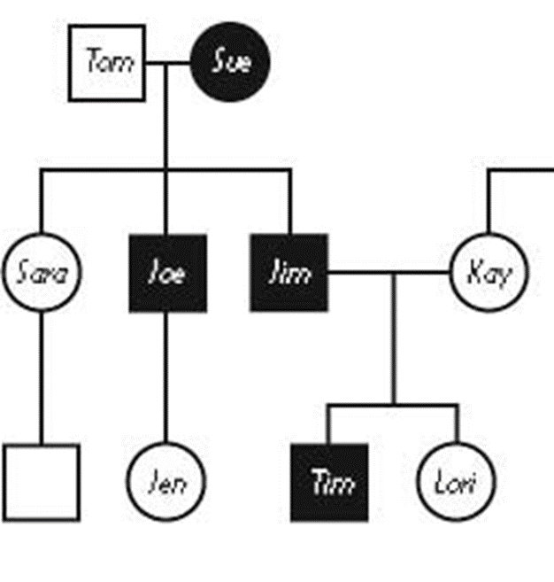
Review
4. What type of inheritance pattern is shown in this pedigree? Explain.
5. What genotype is
Tom
Sue
Joe

Slide 4
Learning Intentions
investigating the applications of gene technologies such as gene therapy and genetic engineering
considering the use of genetic testing for decisions such as genetic counselling, embryo selection, identification of carriers of genetic mutations and the use of this information for personal use or by organisations such as insurance companies or medical facilities

Slide 5
Success Criteria
Give three examples of genetic engineering
Explain why GMOs are controversial and tightly controlled in Australia.

Slide 6
Gene Technology
Gene technology is the term given to a range of activities concerned with understanding gene expression, taking advantage of natural genetic variation, modifying genes and transferring genes to new hosts.

Slide 7


Slide 8
Examples
Gene silencing, is a way of reducing or switching off the activity of genes. Researchers from CSIRO and the University of Melbourne's Murdoch Children's Research Institute (MCRI) have successfully silenced a gene in chicken embryos, causing testis to become ovaries, bringing about a male to female sex reversal. This discovery is not only a breakthrough in understanding sex determination in animals, it also has taken MCRI researchers closer to uncovering genetic causes of sex development disorders in humans.

Slide 9


Slide 10
Examples
We use gene technology in crop and animal research to improve the sustainability and productivity of agriculture and to protect plants, animals and humans from disease. For example, we used genetic testing to speed up conventional breeding of our black tiger prawn and introduced a gene into cotton to help it resist the Helicoverpa larvae.

Slide 11


Slide 12
Success Criteria
Give three examples of genetic engineering
Explain why GMOs are controversial and tightly controlled in Australia.

